Slide 1
FGT with GWLB and TGW Security Inspection
LiuGang
2023-11-30

Slide 2












逻辑拓扑
cloudfront
Route53
IGW
App VPC-1
TGW attachment
Security VPC
TGW attachment
AZ1
Endpoints
NAT gateway
FortiGate
TGW
GWLB
ALB
Endpoints
NAT gateway
App VPC-2
AZ2
TGW attachment
TGW attachment
FGT integrate with TGW and GWLB 南北和东西向流量上云安全检查

Slide 3
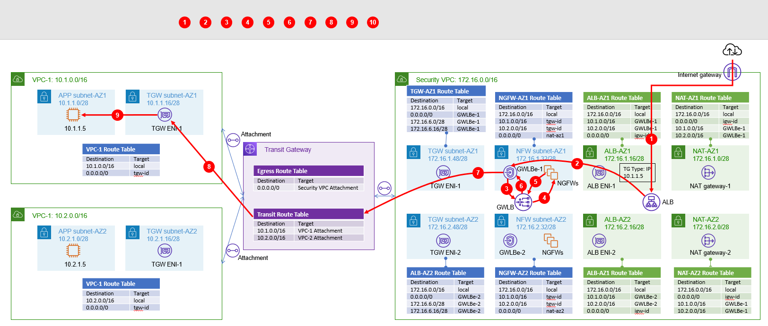
北向入向流量

Slide 4
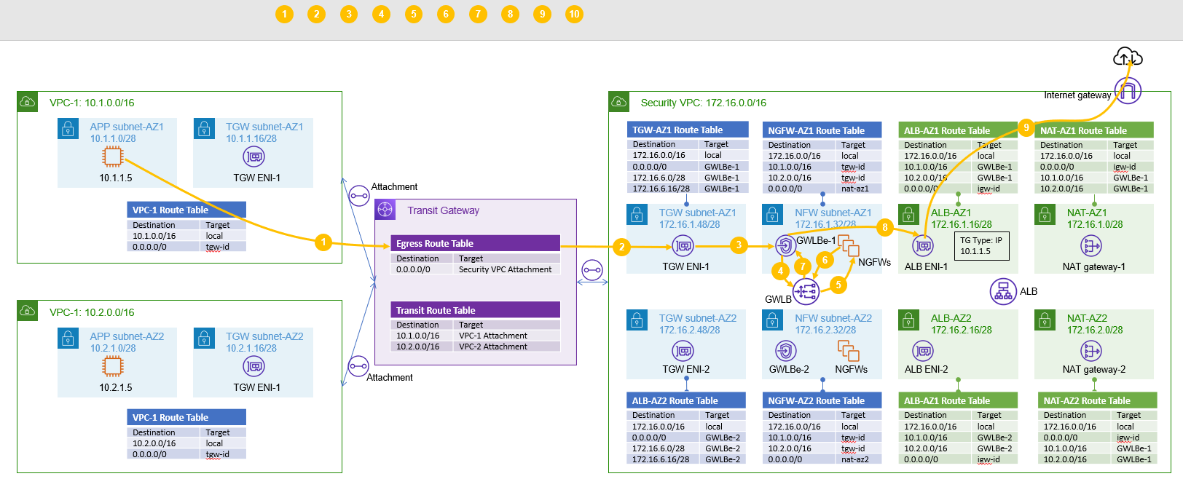
北向回包流量

Slide 5
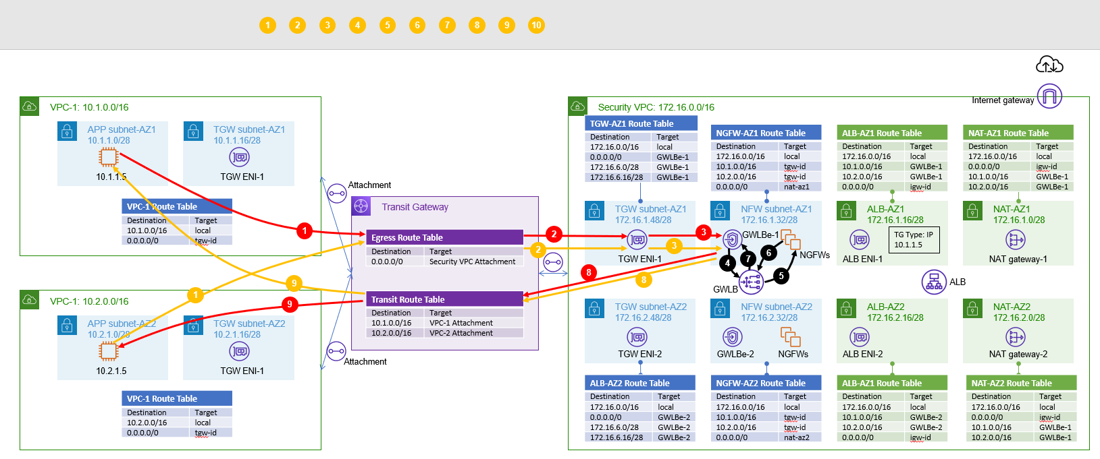
东西向流量

Slide 6
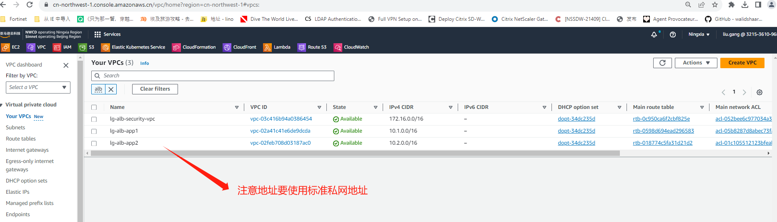
VPC规划

Slide 7
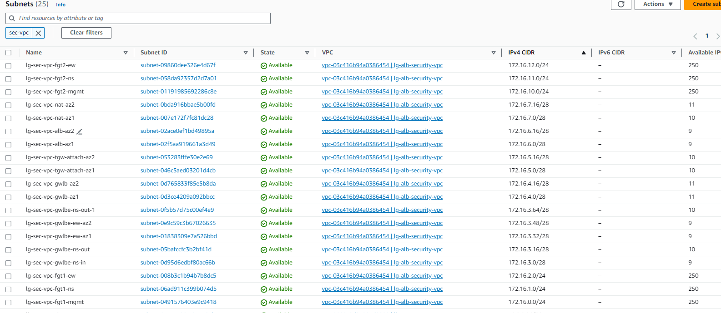
Security VPC Subnet规划
防火墙每台设备3块网卡，分别用于管理口、南北流量控制业务接口、东西向业务控制接口;
NAT/ALB/GWLB/GWLBE(NS[in/out]/EW)/tgw attachment建议基于Server部署AZ来规划，通常建议双AZ部署提升冗余性；
Notes:
目前推荐c6g.large实例使用基于graviton arm镜像FGT

Slide 8
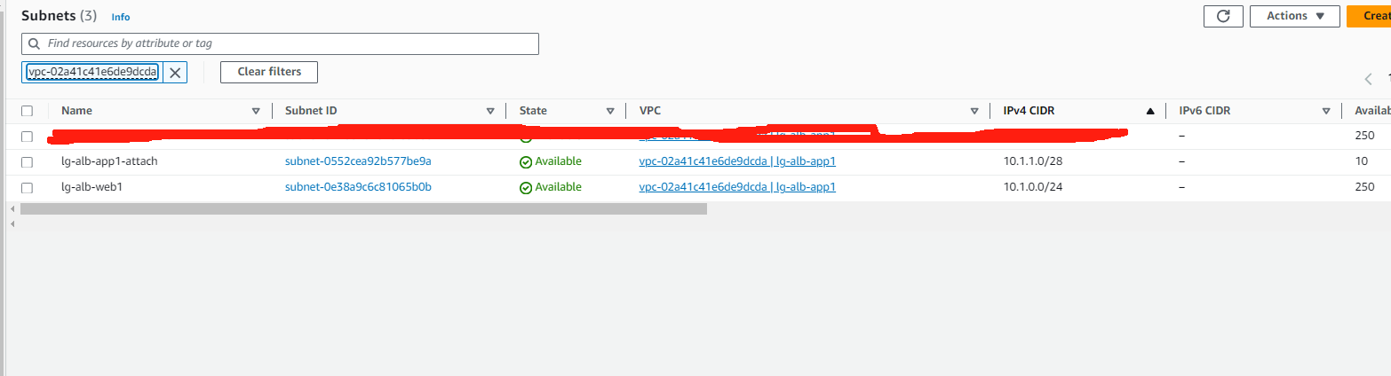
App VPC-1规划
Server/TGW Attachment建议基于Server部署AZ来规划，通常建议双AZ部署提升冗余性；

Slide 9
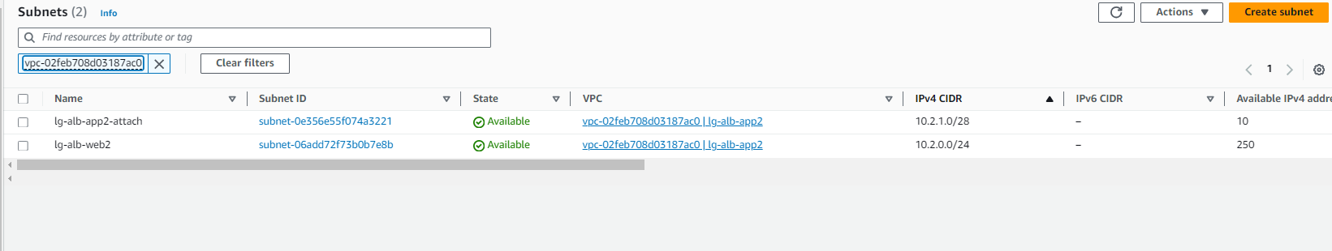
App VPC-2规划
Server/TGW Attachment建议基于Server部署AZ来规划，通常建议双AZ部署提升冗余性；

Slide 10
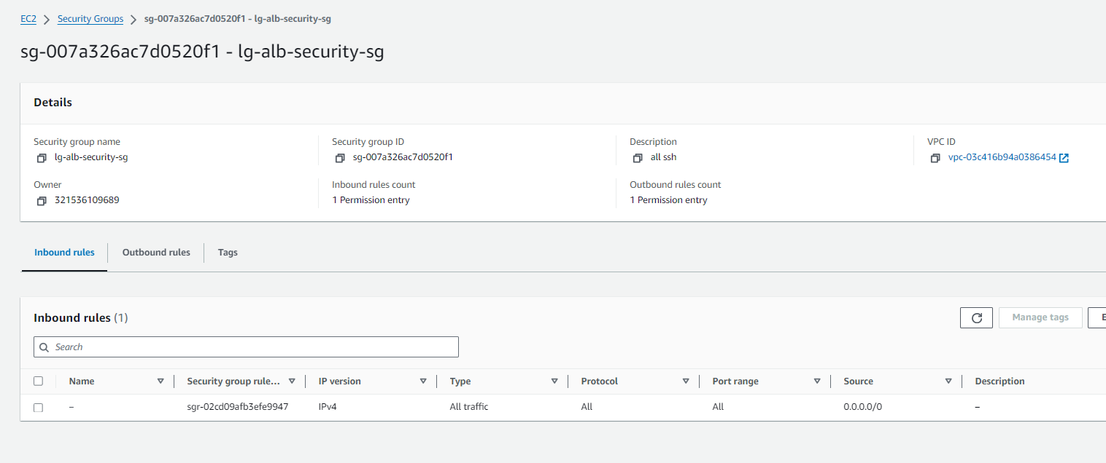
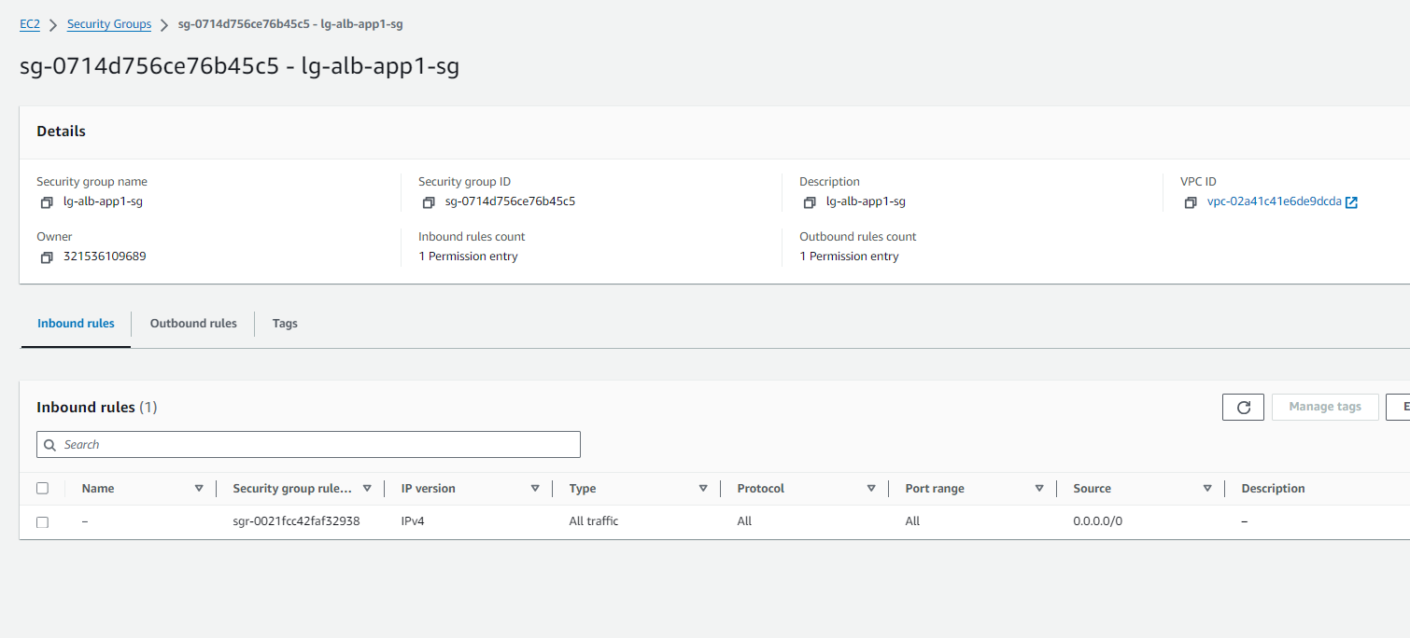
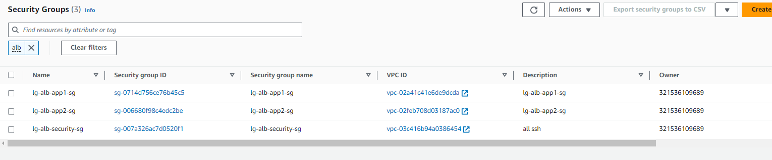
安全组
安全组防火墙管理口建议开通443 22
业务几口流量可以全开或者仅开通UDP 6081（Geneve隧道） TCP 8008（probe-http健康检查） 以及业务需要开通的端口 例如443 80等

Slide 11
防火墙配置(vdom global and root)
config system vdom-property
edit "root"
set description "property limits for vdom root"
set snmp-index 1
next
edit "EW-Traffic"
set description "property limits for vdom EW-Traffic"
set snmp-index 3
next
edit "NS-Traffic"
set description "property limits for vdom NS-Traffic"
set snmp-index 2
next
End
config system probe-response
set mode http-probe
End
config router static
edit 1
set gateway x.x.x.1(AWS subnet 网关地址)
set device "port1"
next
end
config system interface
edit "port1"
set vdom "root"
set ip x.x.x.x
set allowaccess ping https ssh
set type physical
set snmp-index 1
set mtu-override enable
set mtu 9001
next
edit "port2"
set vdom "NS-Traffic"
set ip x.x.x.x
set allowaccess ping probe-response
set type physical
set snmp-index 6
set defaultgw disable
set mtu-override enable
set mtu 9001
next
edit "port3"
set vdom "EW-Traffic"
set ip x.x.x.x
set allowaccess ping probe-response
set type physical
set snmp-index 7
set defaultgw disable
set mtu-override enable
set mtu 9001
next
手工设置管理路由防止地址丢失导致无法管理
port1划入root vdom ， port2划入 NS vdom ，port3划入EW vdom
开启probe-response探测功能

Slide 12
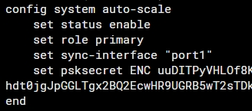
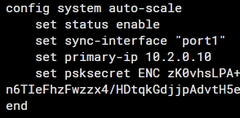
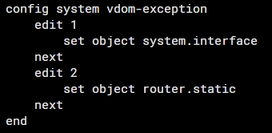
FGT配置auto-scale
通过配置auto-scale实现配置自动同步，FQDN解析记录也会同步

Slide 13
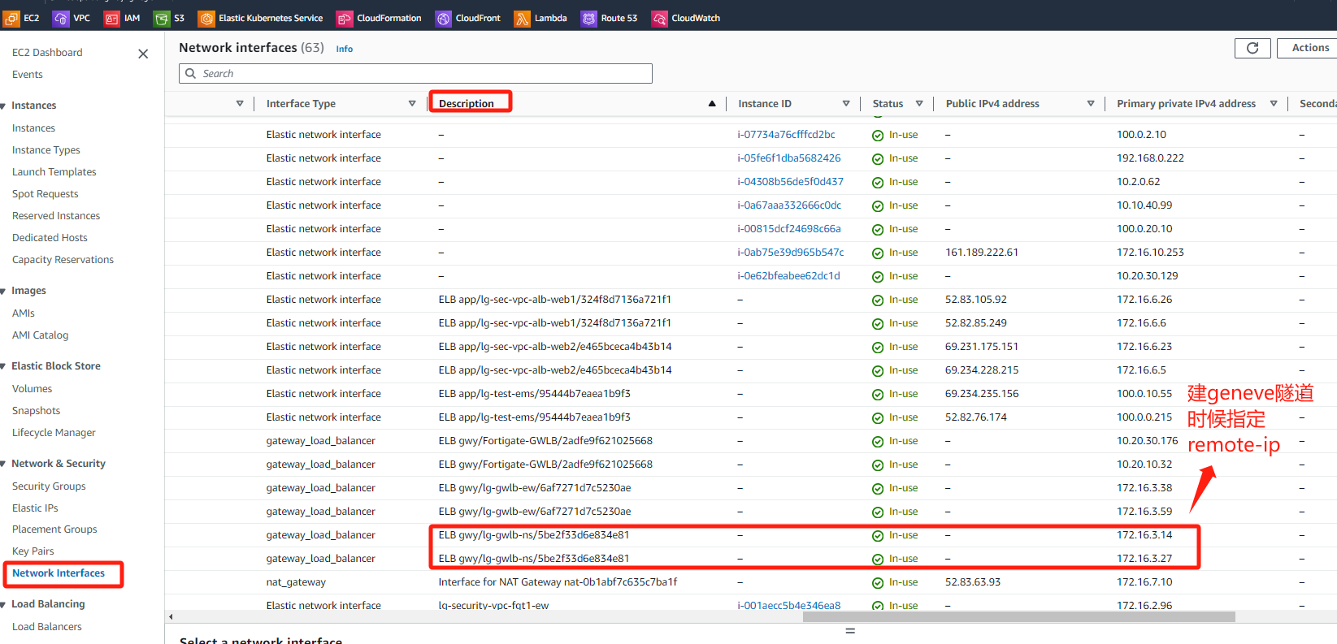
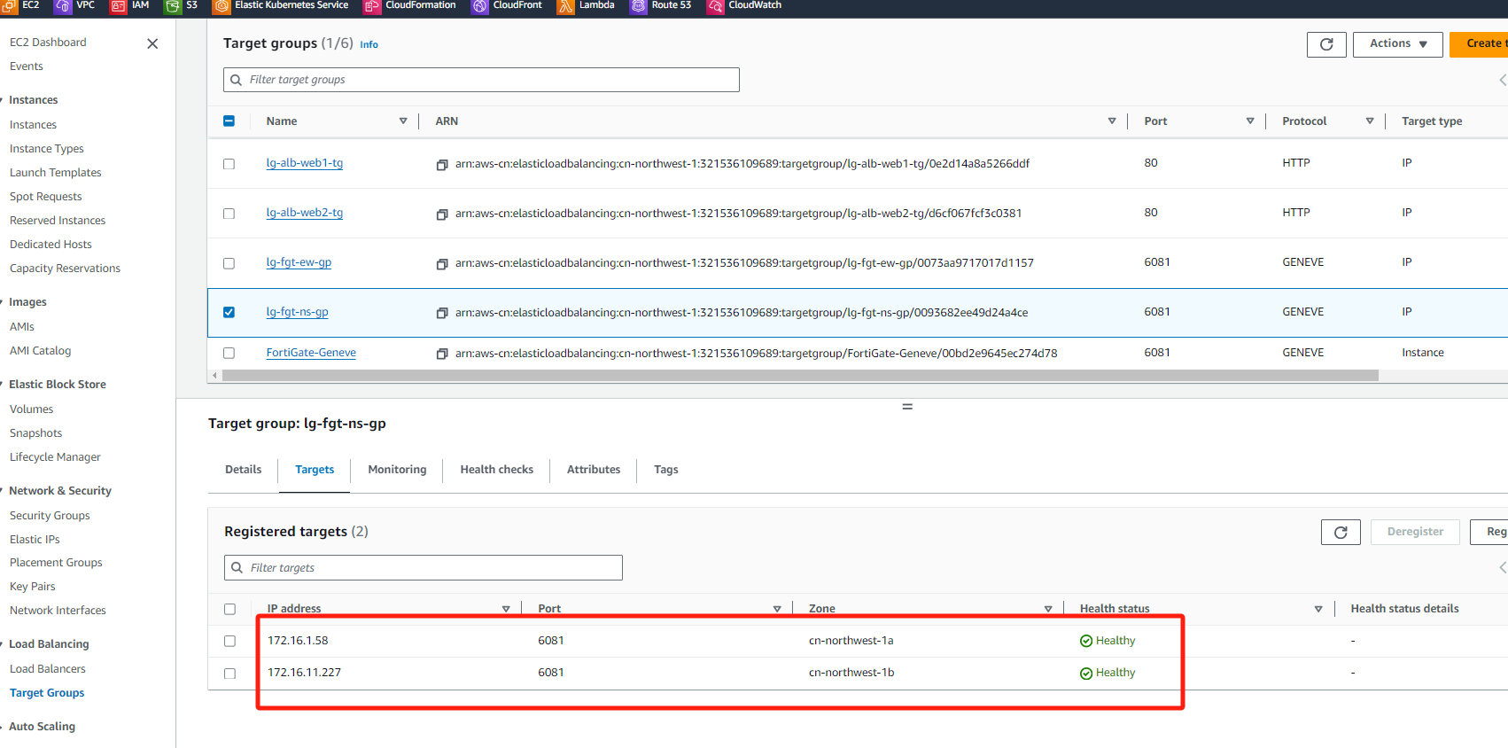
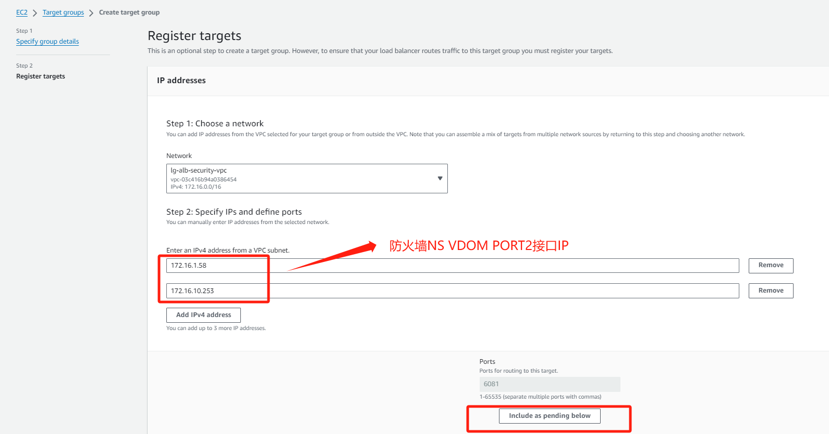
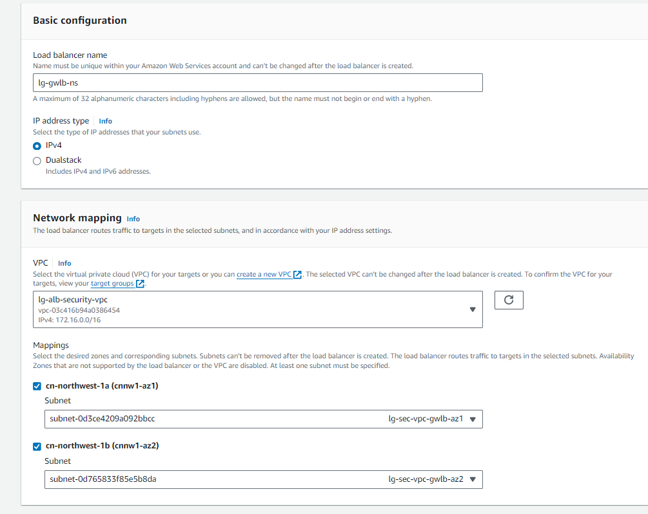
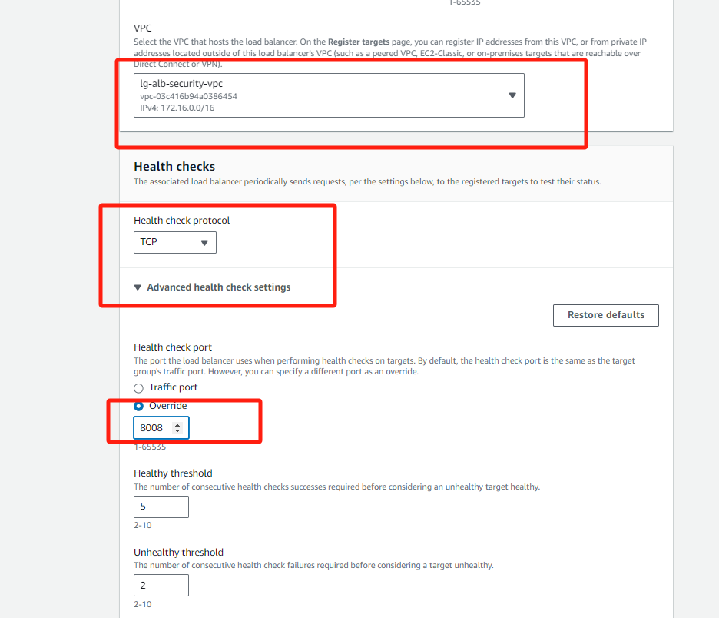
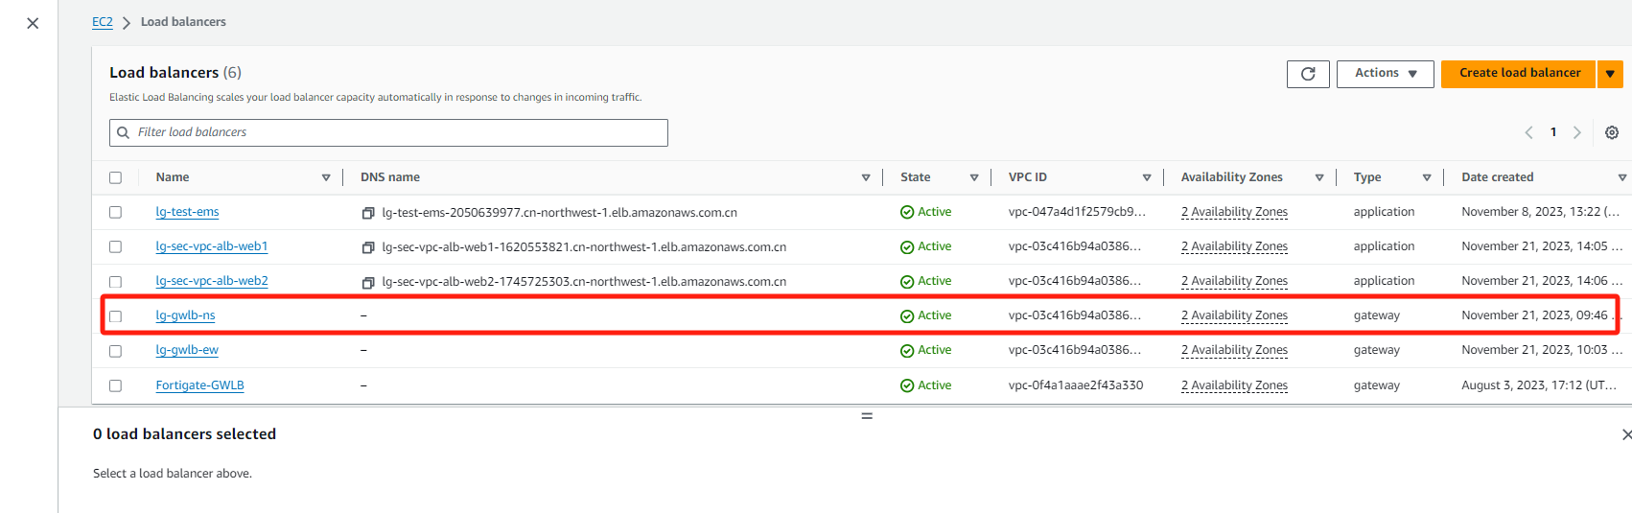
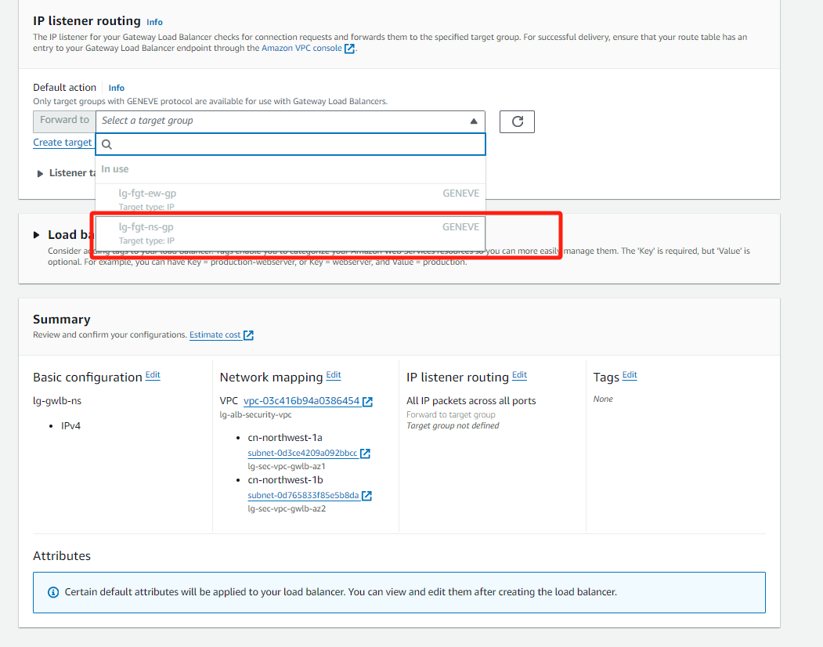
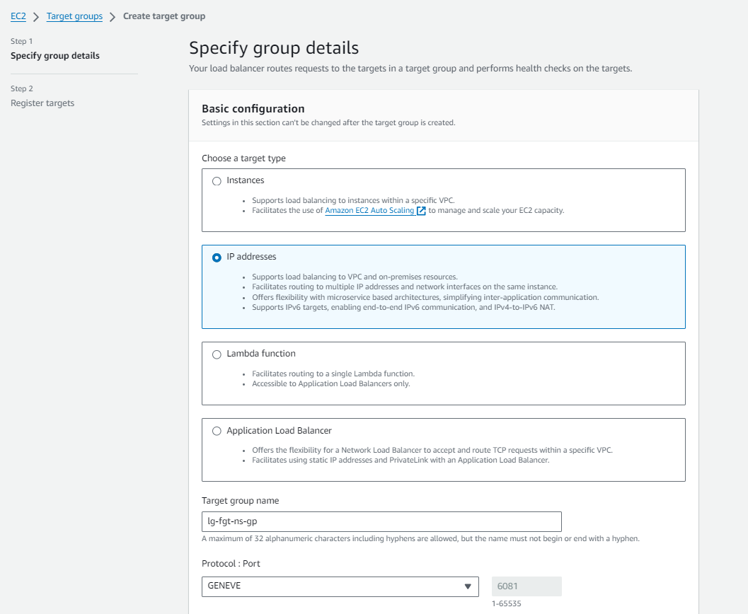
GWLB-NS

Slide 14
防火墙配置(vdom NS)
config system geneve
edit "geneve-ns-1"
set interface "port2"
set type ppp
set remote-ip x.x.x.x (gwlb配置后查看gwlb eni获取网卡地址)
next
edit "geneve-ns-2"
set interface "port2"
set type ppp
set remote-ip x.x.x.x
next
End
config router static
edit 1
set dst x.x.x.x x.x.x.x (回指GWLB ENI网段的路由)
set gateway x.x.x.x
set device "port2"
next
edit 2
set device "geneve-ns-1"
next
edit 3
set device "geneve-ns-2"
next
end
config firewall policy
edit 1
set name "NS-Traffic-Policy"
set srcintf "NS-Traffic-Zone"
set dstintf "NS-Traffic-Zone"
set action accept
set srcaddr "all"
set dstaddr "all"
set schedule "always"
set service "ALL"
set utm-status enable
set ssl-ssh-profile "deep-inspection"
set av-profile "g-default"
set ips-sensor "g-default"
set logtraffic all
set tcp-mss-sender 1000 (用于处理ALB过来的流量)
set tcp-mss-receiver 1000
next
end
config router policy
edit 1
set input-device "geneve-ns-1"
set output-device "geneve-ns-1"
next
edit 2
set input-device "geneve-ns-2"
set output-device "geneve-ns-2"
next
End
config system zone
edit "NS-Traffic-Zone"
set interface "geneve-ns-1" "geneve-ns-2"
next
End

Slide 15
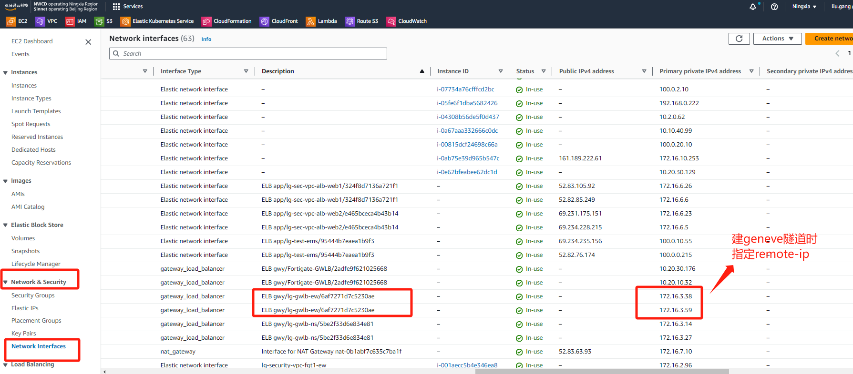
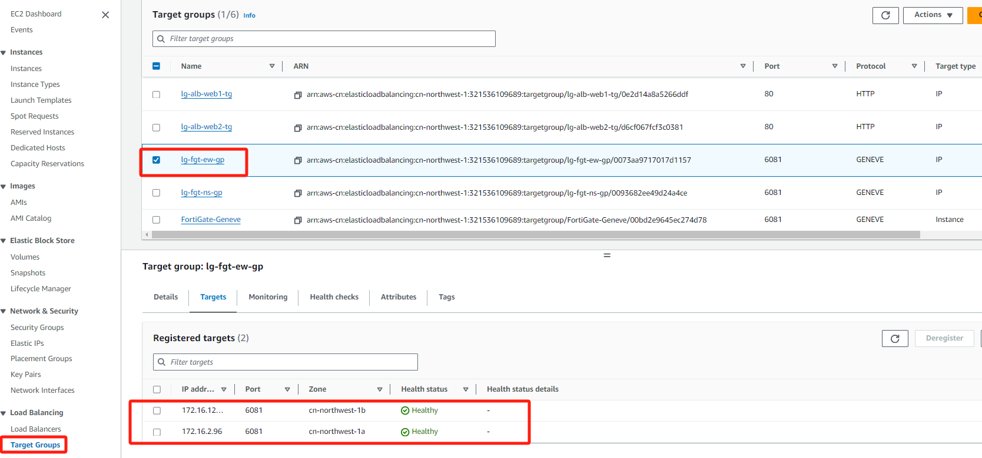
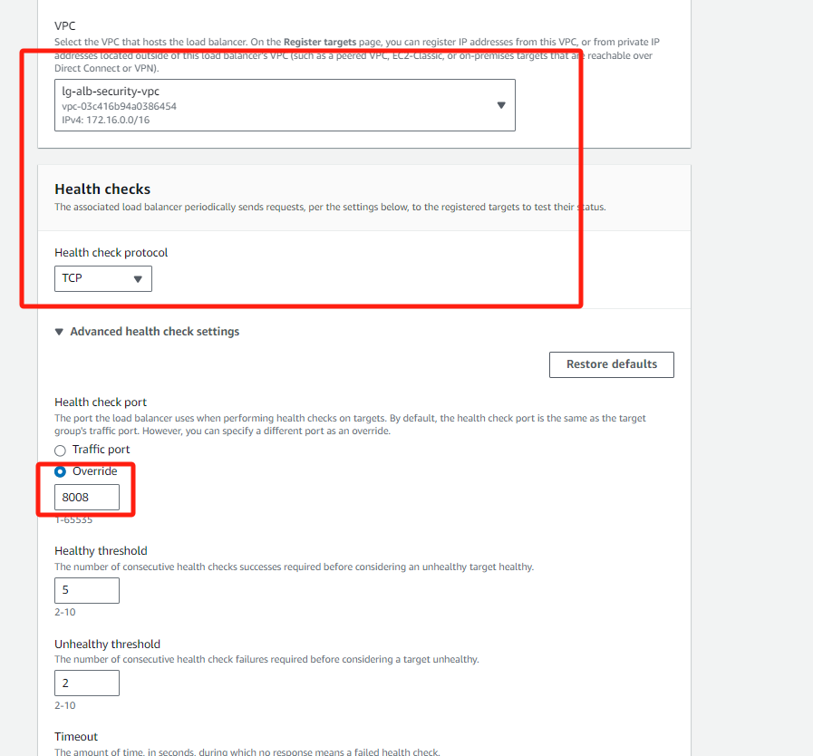
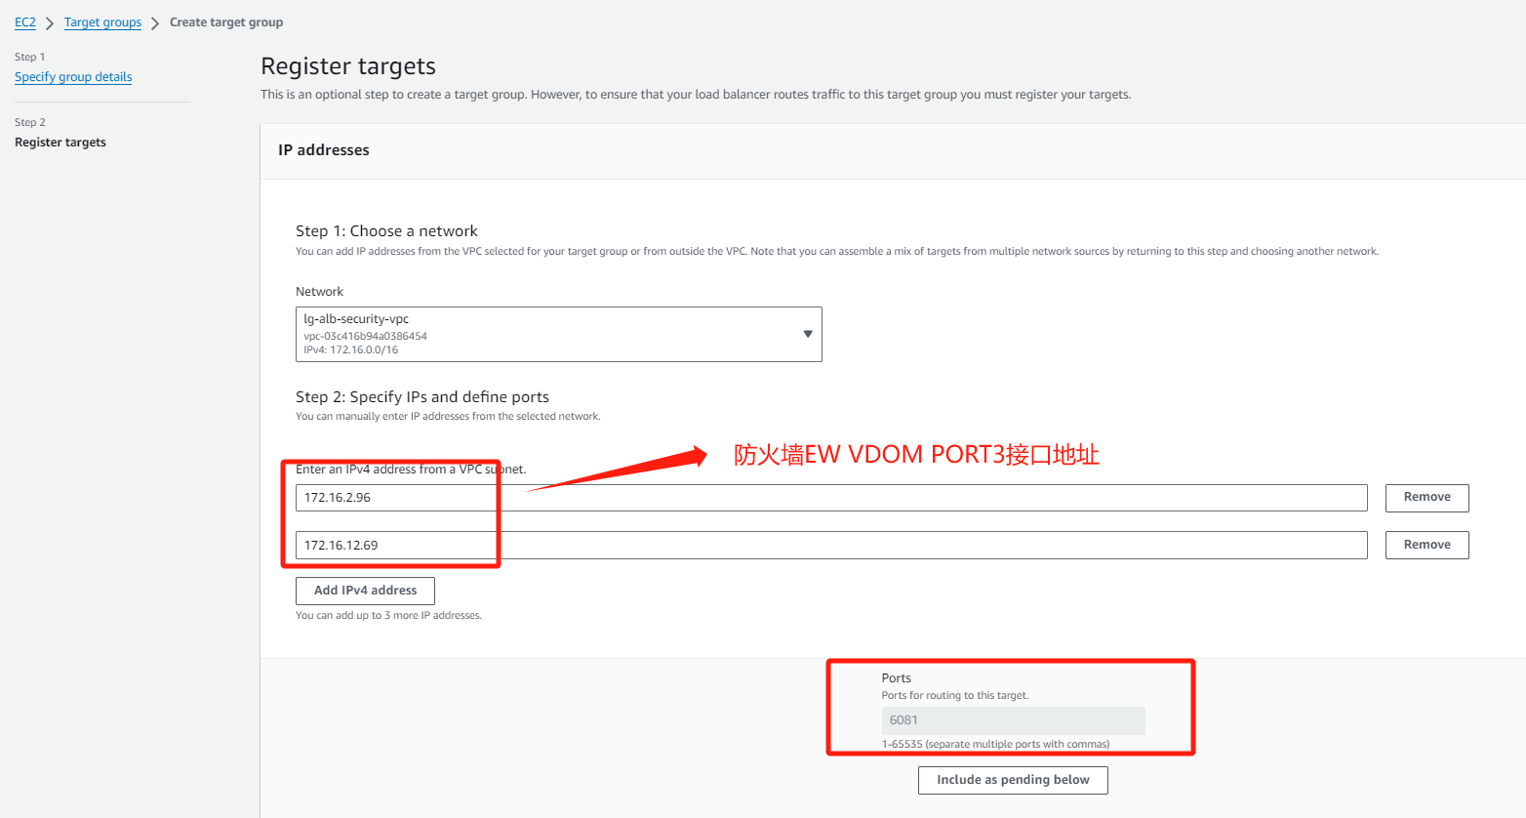
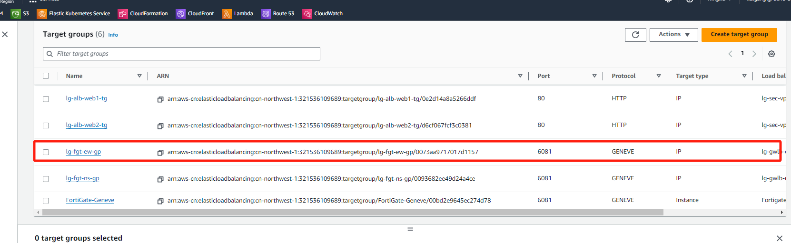
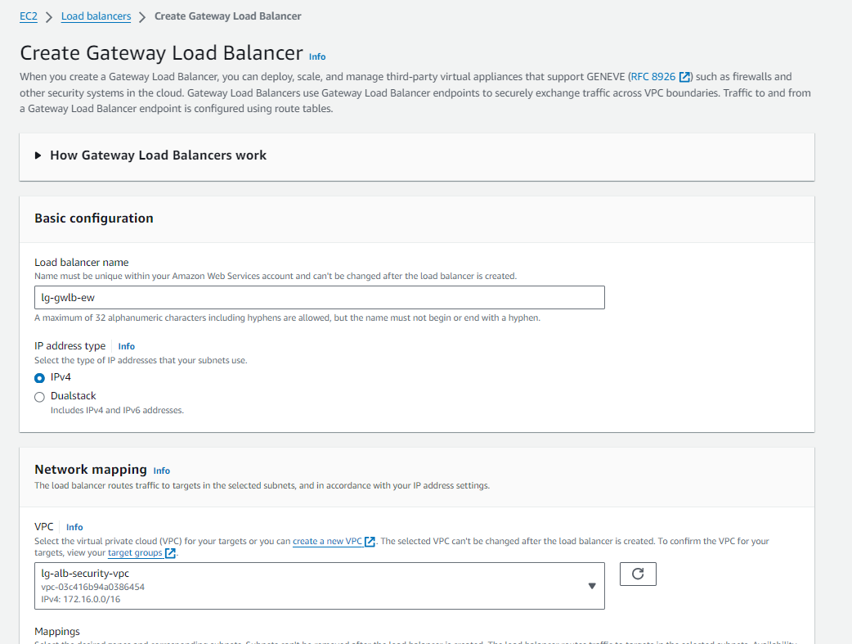
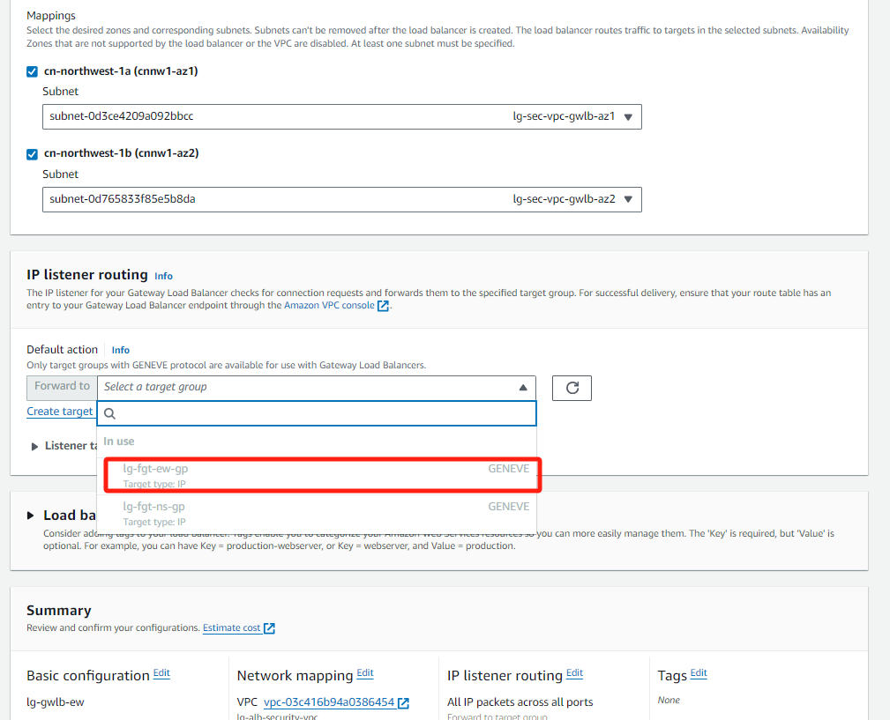
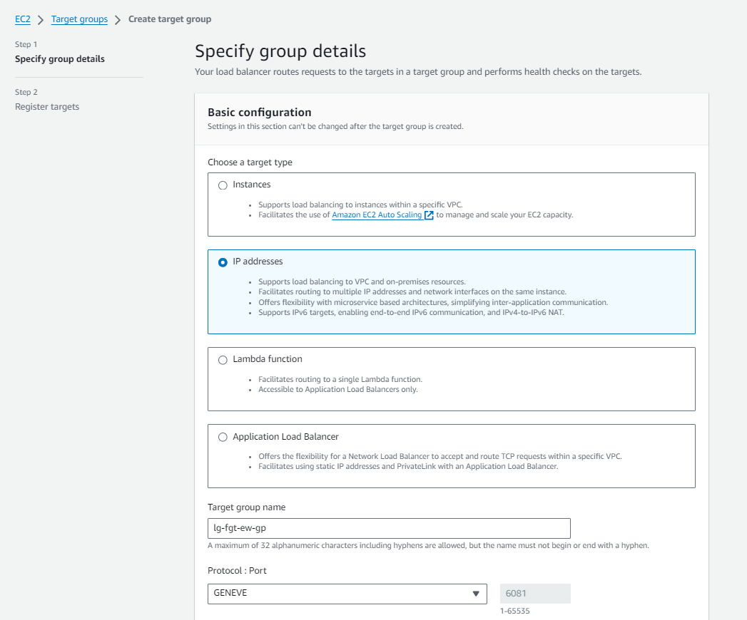
GWLB-EW

Slide 16
防火墙配置(vdom EW)
config system geneve
edit "geneve-ns-1"
set interface "port3"
set type ppp
set remote-ip x.x.x.x (gwlb配置后查看gwlb eni获取网卡地址)
next
edit "geneve-ns-2"
set interface "port3"
set type ppp
set remote-ip x.x.x.x
next
End
config router static
edit 1
set dst x.x.x.x x.x.x.x (回指GWLB ENI网段的路由)
set gateway x.x.x.x
set device "port3"
next
edit 2
set device "geneve-ew-1"
next
edit 3
set device "geneve-ew-2"
next
end
config router policy
edit 1
set input-device "geneve-ew-1"
set output-device "geneve-ew-1"
next
edit 2
set input-device "geneve-ew-2"
set output-device "geneve-ew-2"
next
End
config system zone
edit "NS-Traffic-Zone"
set interface "geneve-ew-1" "geneve-ew-2"
next
End
config firewall policy
edit 1
set name "EW-Traffic-Policy"
set srcintf "EW-Traffic-Zone"
set dstintf "EW-Traffic-Zone"
set action accept
set srcaddr "all"
set dstaddr "all"
set schedule "always"
set service "ALL"
set utm-status enable
set ssl-ssh-profile "certificate-inspection"
set av-profile "g-default"
set ips-sensor "g-default"
set logtraffic all
next
end

Slide 17
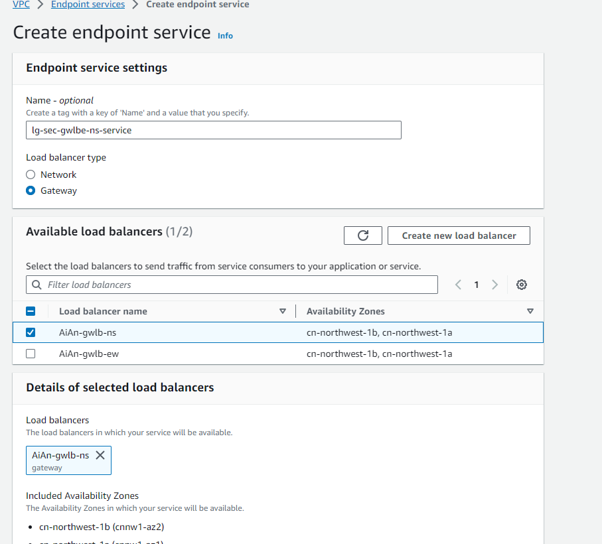
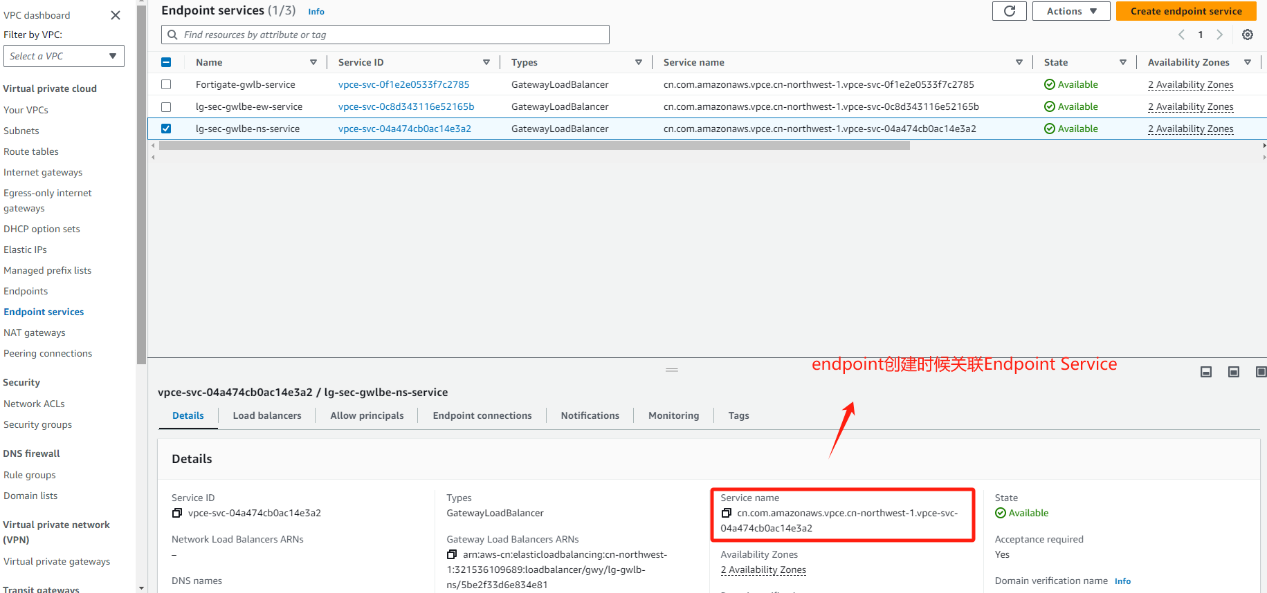
Endpoint Service规划

Slide 18
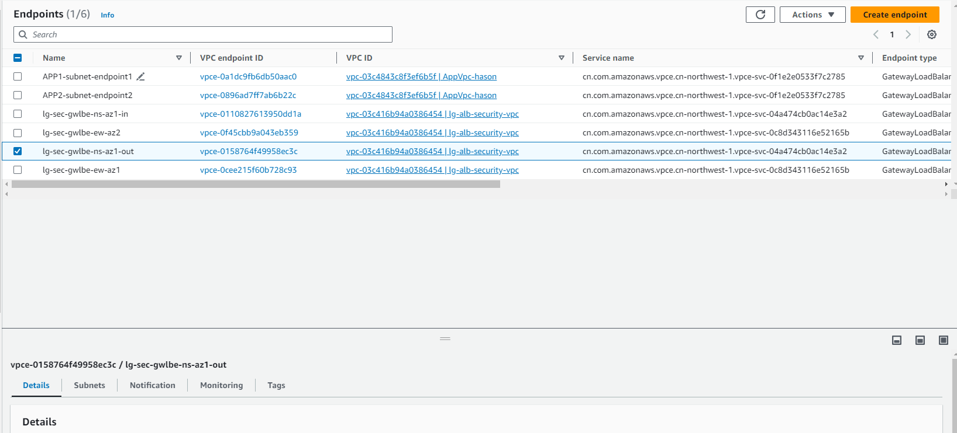
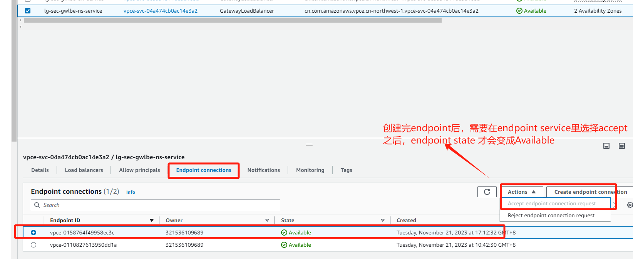
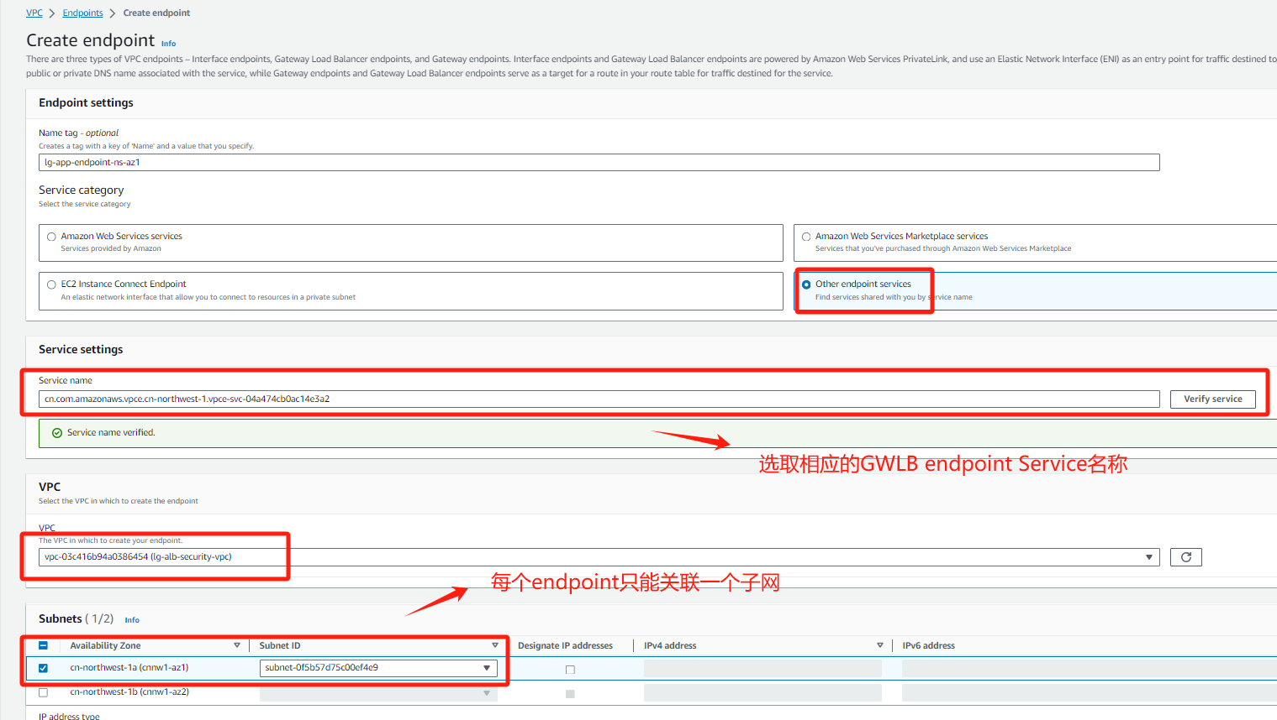
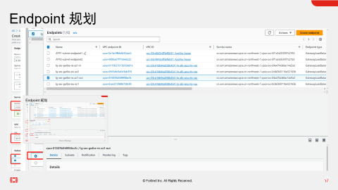

Endpoint 规划

Slide 19
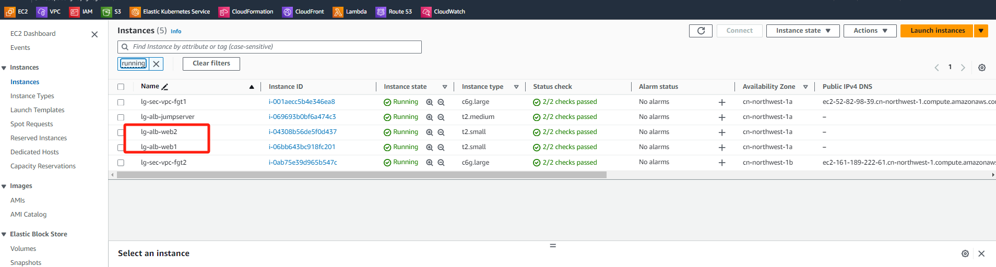
业务ECS实例创建
验证环境总共2台ECS WEB服务器分别位于不同VPC，一台跳板机用于测试东西流量访问，2台防火墙FGT部署在security VPC

Slide 20
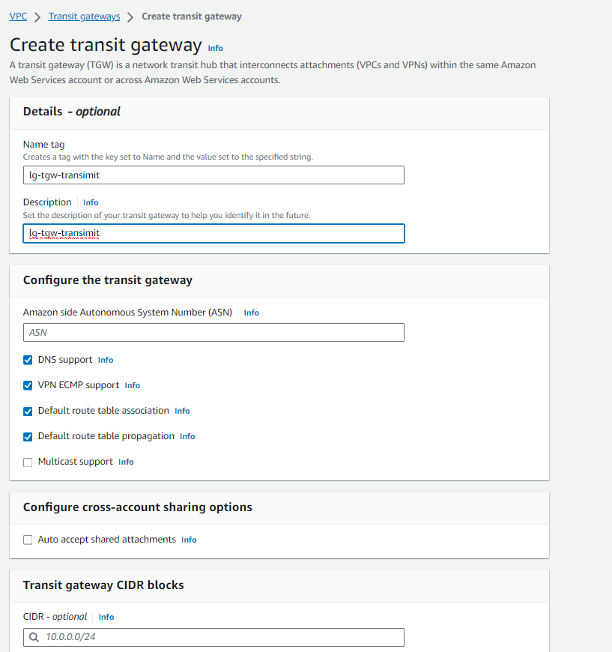
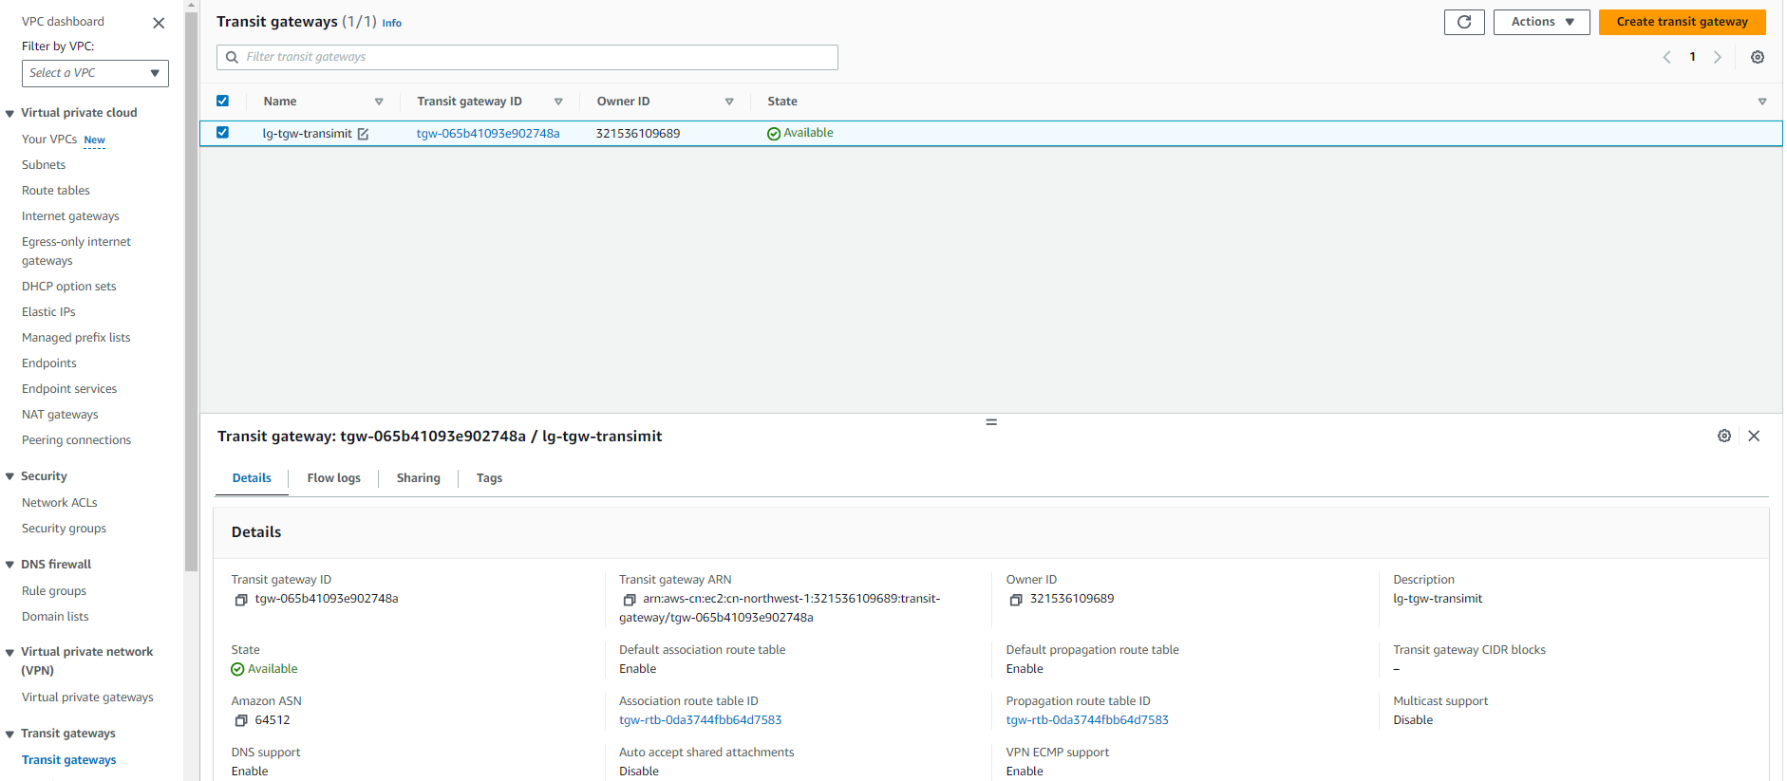
TGW规划

Slide 21
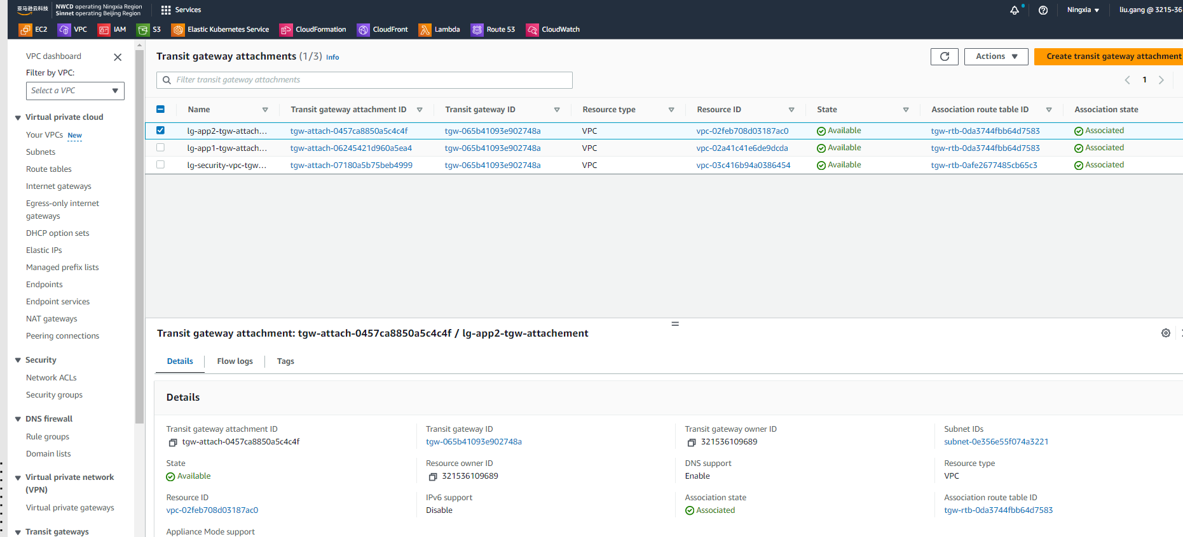
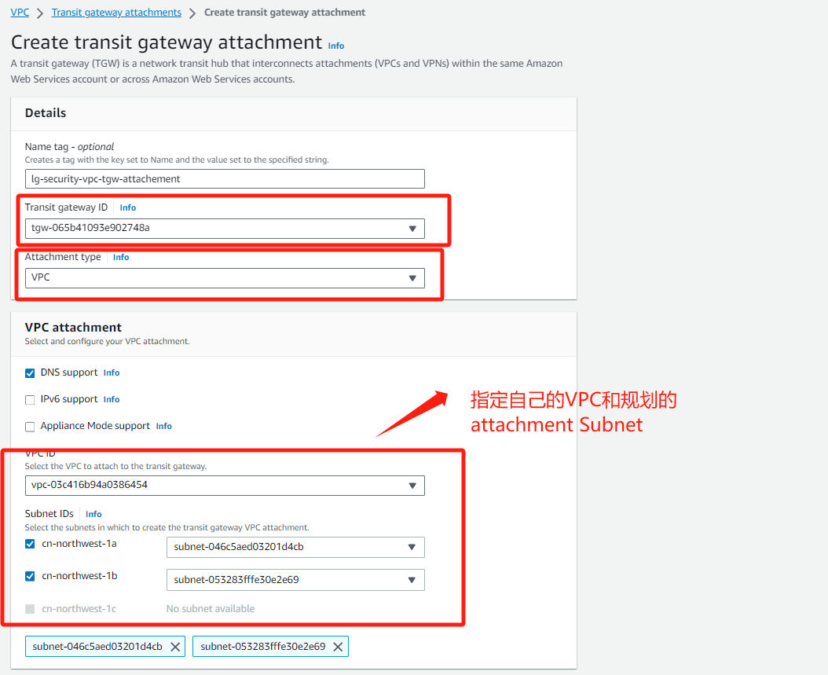
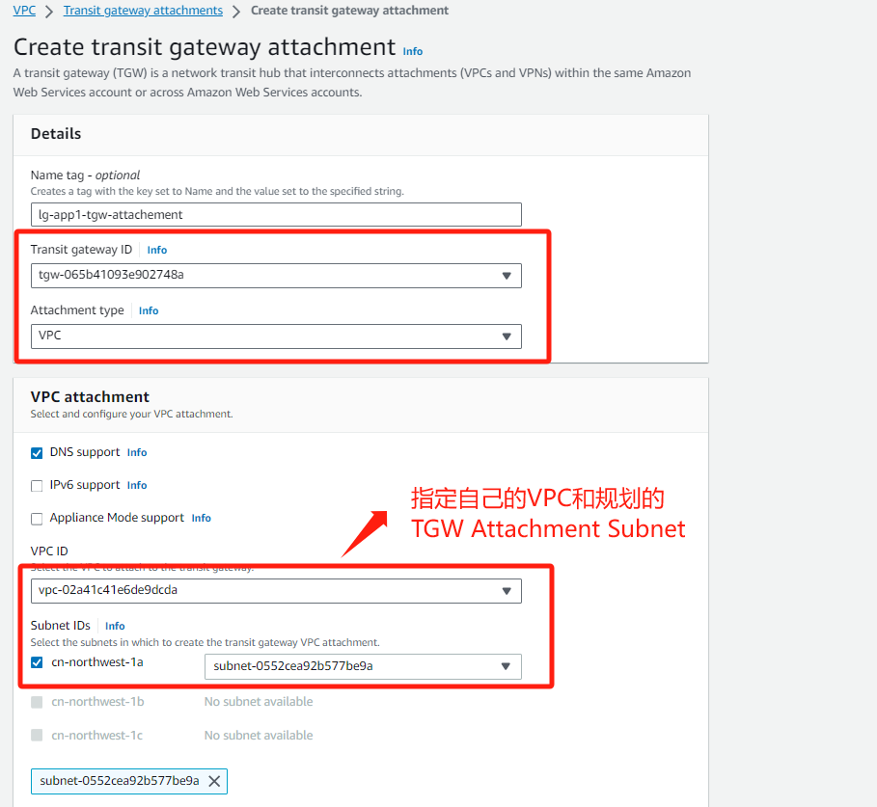
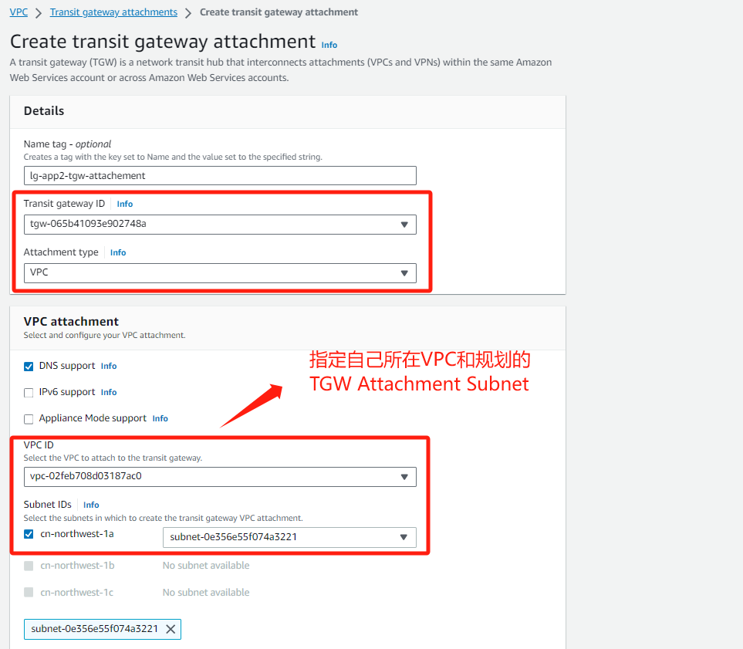
TGW Attachment规划

Slide 22
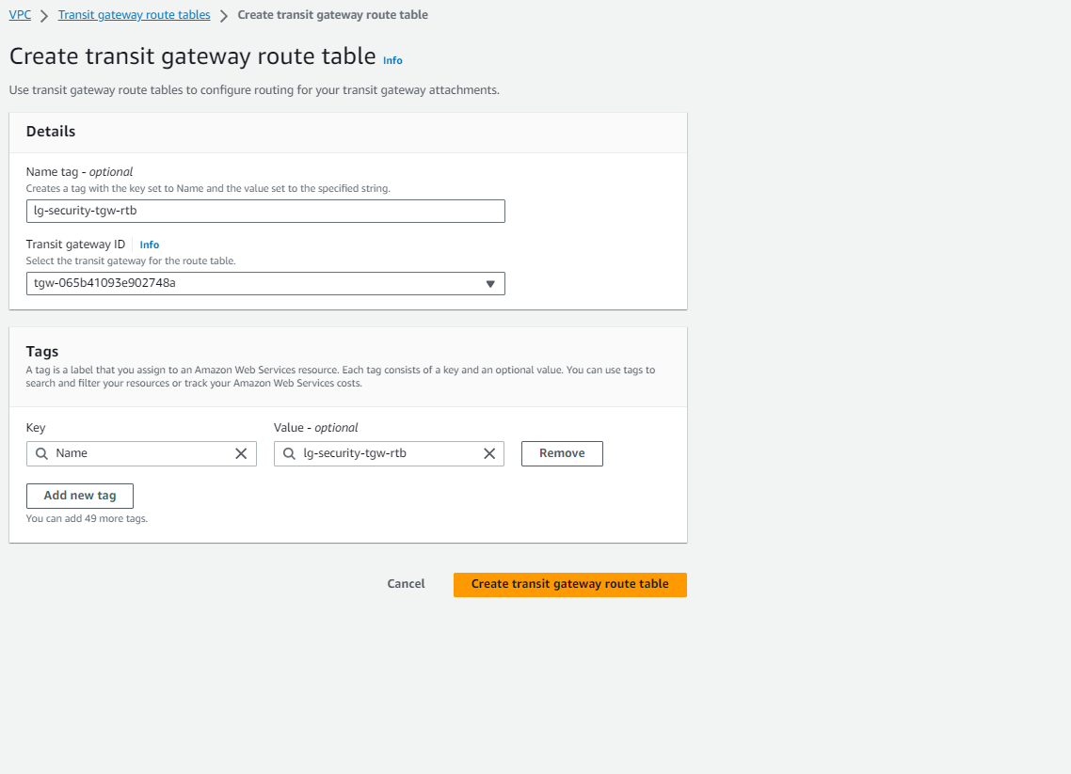
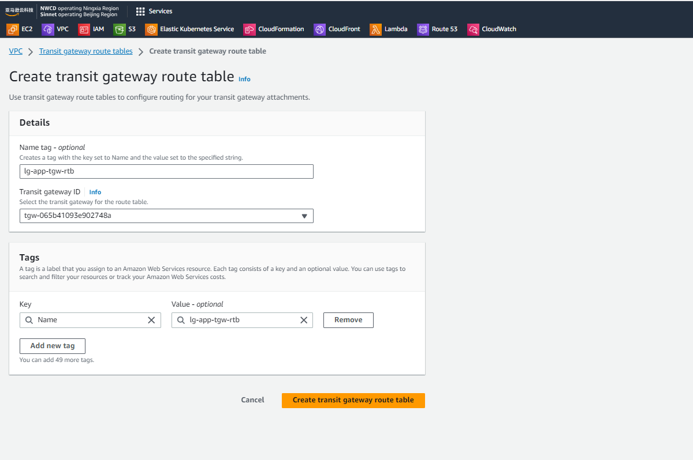
TGW 路由规划-1

Slide 23
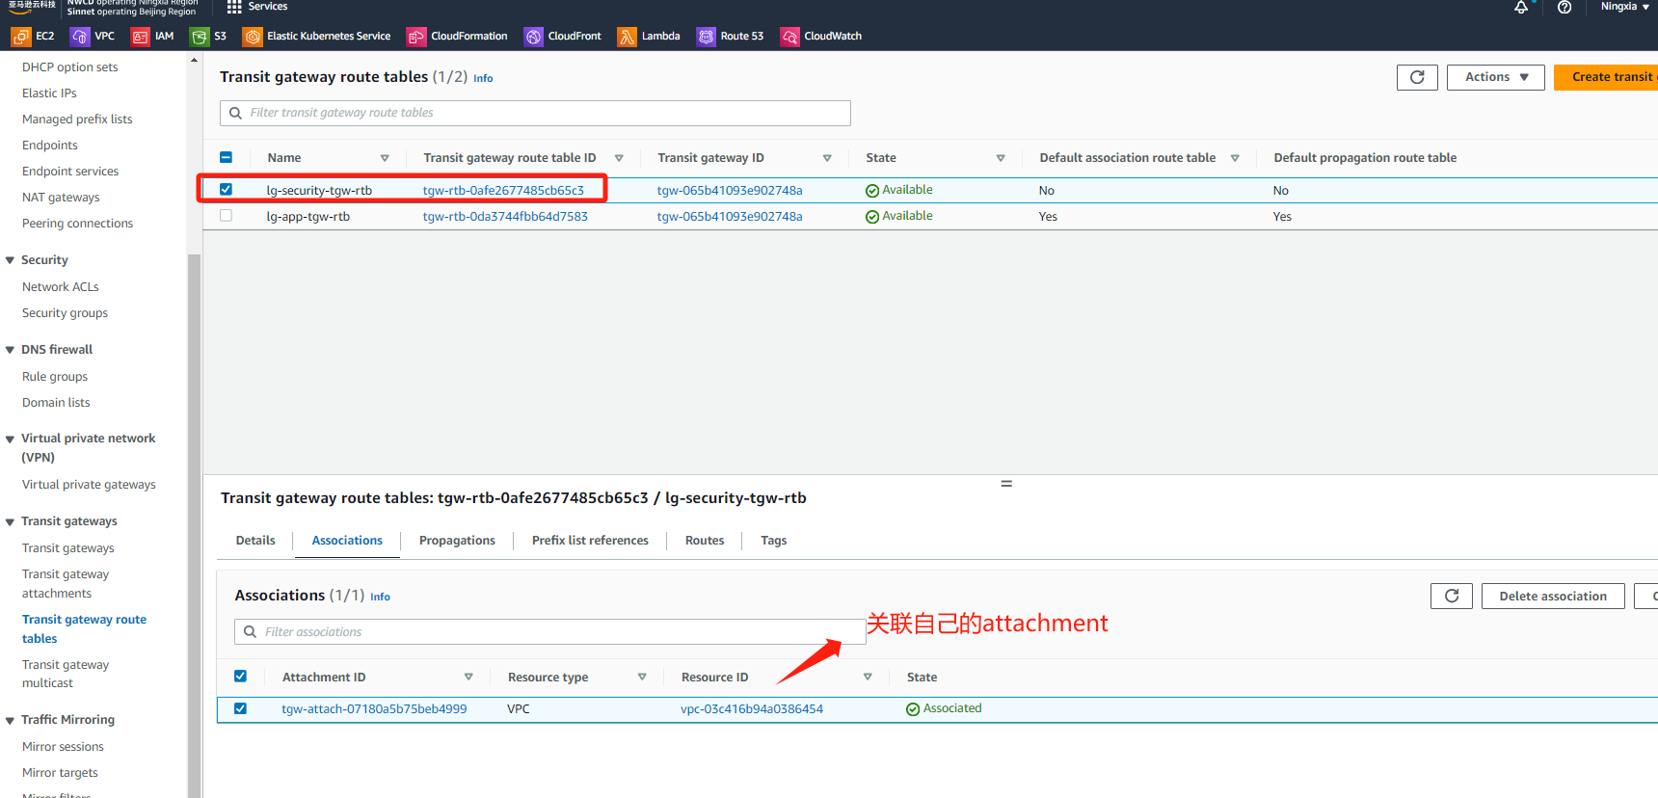
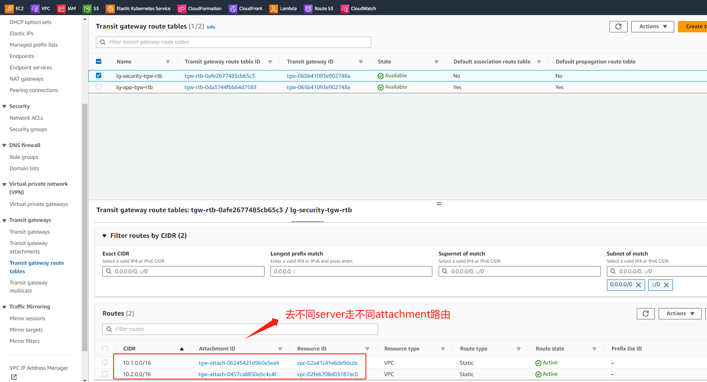
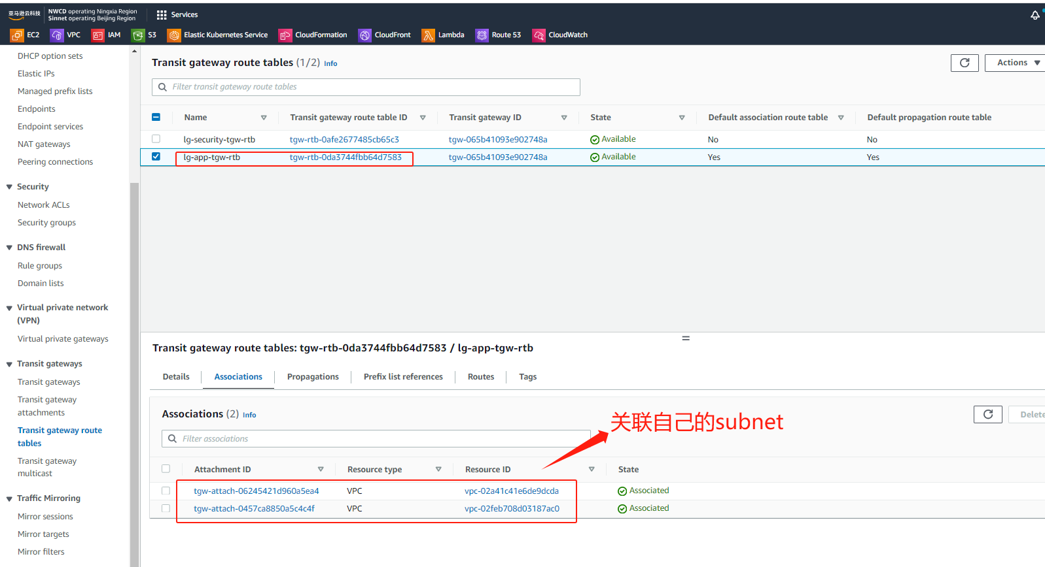
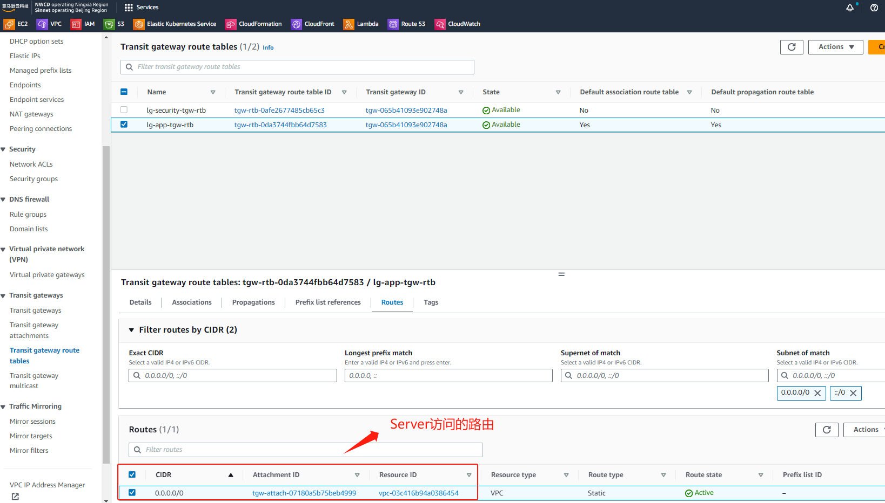
TGW 路由规划-2

Slide 24
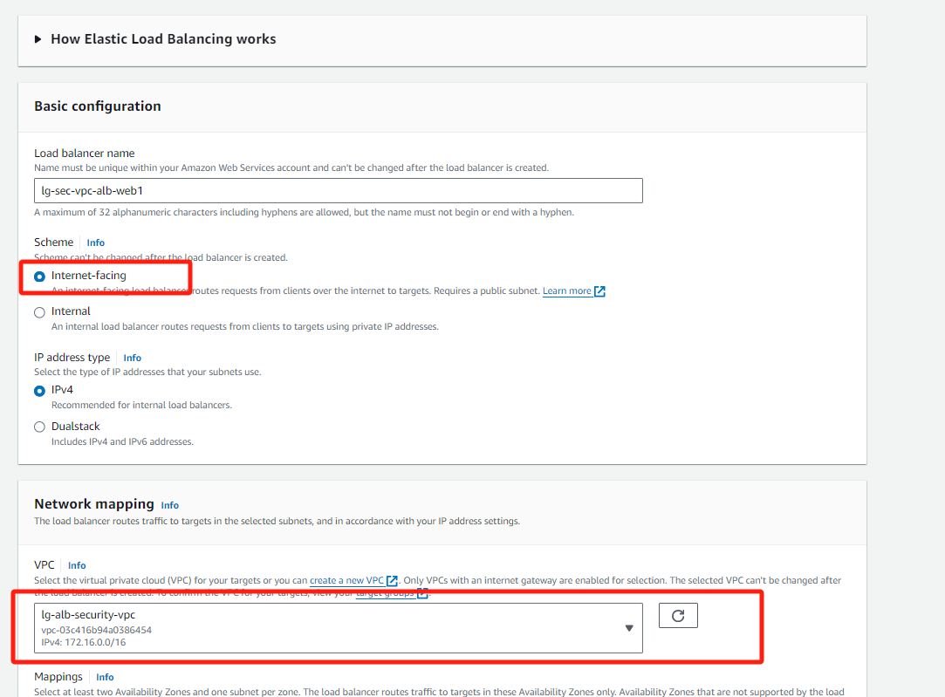
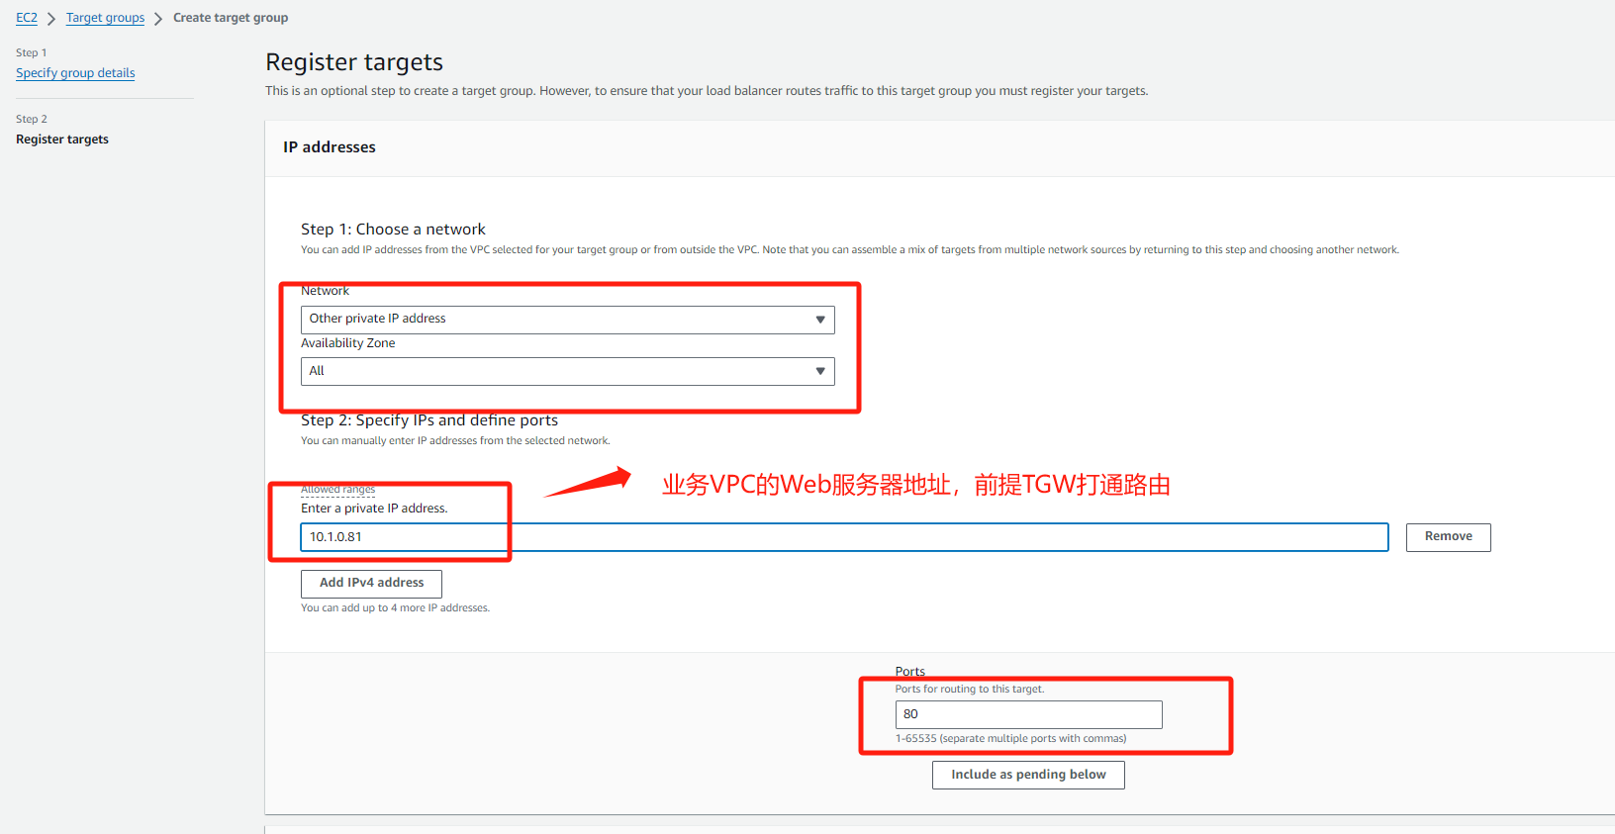





业务ALB-1

Slide 25









业务ALB-2

Slide 26


NAT规划

Slide 27

FGT管理路由表

Slide 28



App-1 路由表-1

Slide 29


App-1 路由表-2

Slide 30



App-2 路由表-1

Slide 31


App-2 路由表-2

Slide 32


GWLBe-NS 路由表

Slide 33


GWLBe-EW 路由表

Slide 34


*Sec VPC TGW Attachment路由表*

Slide 35


Alb-1路由表

Slide 36


Alb-2路由表

Slide 37


NAT路由表

Slide 38

业务测试-南北互访-1
Notes:
访问ALB对外发布的两个业务分别对应不同VPC的Server

Slide 39


业务测试-南北互访-2
Notes:
两台防火墙分别记录2个不同请求的业务会话

Slide 40

业务测试-南北互访-3
Notes:
远程通过跳板机访问app-web-1 server 去访问公网和测试下载病毒文件

Slide 41


业务测试-南北互访-4
Notes:
防火墙阻断下载病毒请求和放通了PING流量

Slide 42

业务测试-东西互访-1
Notes:
远程通过跳板机访问app-web-1 server 去访问app-web-2 server 应用和ICMP

Slide 43

业务测试-东西互访-2
Notes:
防火墙放通流量日志

